Slide 1
Sound and audio

Slide 2
Table of Content
Introduction
Properties of sound
Characteristics of digital sound
Calculate audio data size
Benefits of using digital audio
Audio file formats
Sound in multimedia application
Editing digital recording

Slide 3
Introduction: Sound Vs Audio
Audio means the reproduction of sound.
Classes of Sound:
Voice
  Defined as talking.
Music
Sound Effect:
  Voice or Music; but often created by natural events like thunderclap, wind and door slamming.
Notes:
Some animals, such as dogs, dolphins, bats and mice can hear ultrasound. Focused ultrasound sources may be used to break up kidney stones. Ultrasound cleaners are used for jewellery, watches, dental instruments and surgical instruments.
Infrasound sometimes results naturally from ocean waves, earthquakes, volcanoes and meteors. Infrasound can be generated by man-made process such as explosions. Whales, elephants, giraffes are known to use infrasound to communicate over varying distance of up to many miles as in the case of the whale. Birds use naturally generated infrasound, from sources such as turbulent airflow over mountain ranges, as a navigation aid.

Slide 4
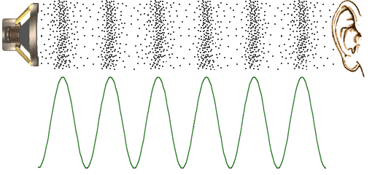
How do We Hear?
Sound waves are variations of pressure in a medium such as air.
Sound created by the vibration of an object, which causes the air surrounding it (medium) to vibrate.
Vibrating air causes the human eardrum to vibrate, which the brain interprets as sound.

Slide 5
Properties of Sound
  frequency
  wavelength
  period
  amplitude
  speed

Slide 6
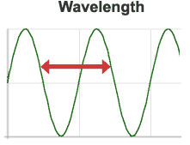
Properties of Sound
Wavelength: Length of wave
Distance between any point on a wave and the equivalent point on the next phase.
Distance between repeating units of a wave pattern.

Slide 7
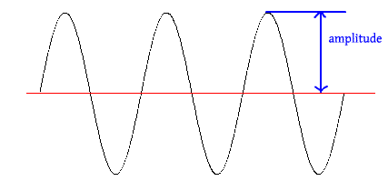
Properties of Sound
Amplitude: The "height" of a wave when viewed as a graph.
The strength or power of a wave signal.
Higher amplitudes are interpreted as a higher volume.

Slide 8
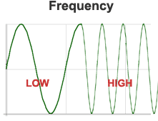
Properties of Sound
Frequency: Number of times the wavelength occurs in one second.
Measured in Hertz (Hz), or cycles per second.
The faster the sound source vibrates, the higher the frequency, the higher the pitch
Example: singing in a
high-pitched voice
forces the vocal chords
to vibrate quickly.

Slide 9
Characteristics of digital sound
Three main characteristics :
  Frequency
    defines the number of samples per second (or per other unit) taken from a continuous signal to make a discrete signal.
    For time-domain signals, it can be measured in hertz (Hz).
  Sound resolution / Amplitude measurement
    Number of bits used to represent a sample.
  Channel
    Mono or stereo

Slide 10
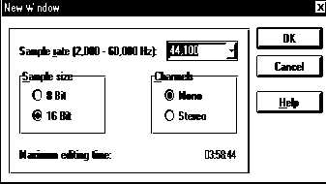
Frequency
A higher frequency sampling rate means more samples; better quality.
The more the samples there are, the more storage space will be needed.
Higher Frequency -> higher quality -> higher storage space
Sound cards are able to record sound at different sampling rates.
Depending on the user’s choice sound can be recorded at 11.025 kHz, 22.05 kHz and 44.1 kHz which is CD quality.

Slide 11
Sound resolution / Amplitude Measurement
Based on 8bits (1 byte).
8 bits for 256 levels & 16 bits for 65536 levels.
The number of bit-sampling too, will affect the size of the file.
The higher the bit-sampling, the larger the size of the file.
Usually, for narrations, 8-bit sampling is quite sufficient.
If you want high quality sound, 16-bit will be a preferred choice.
Higher sound resolution allows very fine differences in sound to be recorded.

Slide 12
Sound channel
Whether you want mono or stereo sound will affect the size of the file.
Mono means sound will be playing from one channel whereas stereo means two channels.
Therefore, stereo sound will require larger storage space than mono sound.

Slide 13
Calculate audio data size
The formula to calculate audio data size:
  C = number of channels (mono = 1 , stereo = 2)
  S = sampling rate in Hz (cycles per second)
  T = Time (seconds)
  B = bytes (1 for 8 bits, 2 for 16 bits)
  File Size = C * S * T * B

Slide 14
Calculate audio data size
Calculate a 30 seconds 16-bit, 44.1 kHz stereo music
Step 1
  44,100 x 2 bytes (or 16-bits) = 88,200 bytes
Step 2
  88,200 x 2 (for stereo) = 176,400 bytes
Step 3
  176,400 x 30 seconds = 5,292,000 bytes

Slide 15
Benefits of using digital audio
Sound can be permanently stored in inexpensive CD.
Consistent sound quality without noise or distortion.
Duplicate will sound exactly the same as the master copy.
Digital sound can be played at any point of the sound track. (random access)
It can also be integrated with other media.
Can be edited without loss in quality.

Slide 16
Audio file formats
Extension Use
wav WAV Audio
aiff Audio (common for Macintosh)
aac Audio (Compressed)
ra Real Audio (stream)
mov QuickTime video
mp3 MP3 Audio

Slide 17
Sound in Multimedia Application
It captures attention.
It increases the associations the end-user makes with the information in their minds.
Sound adds an exciting dimension to an otherwise flat presentation.
Example usage of sound in multimedia application.
  Background music
  Sound effects
  Voice over or narration

Slide 18
Editing Digital Recording
There are abundance of sound editor available such as SoundForge (commercial), Goldwave (shareware), and Audacity(freeware).
The basic sound editing operations that most commonly needed are:
Trimming
Splicing and Assembly
Volume adjustment
Format conversion
Resampling and Downsampling
Fade-ins and Fade-outs
Equalization
Time Stretching
Digital Signal Processing
Reversing Sound

Slide 19
Editing Digital Recording
Trimming
Removing “dead air” or silence space from the front of recording to reduce file size.
Splicing and Assembly
Cutting and Pasting different recording into one.
Volume adjustment
If you combining several recordings into one there is a good chance that you won’t get a consistent volume level. It is best to use a sound editor to normalize the combined audio about 80% – 90% of the maximum level. If the volume is increased too loud, you will hear a distortion.

Slide 20
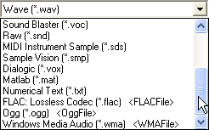
Editing Digital Recording
Format conversion
Saving into different file formats.
Resampling and Downsampling
If you have recorded your sounds at 16-bit sampling rates, you can downsample to lower rates by downsampling the file to reduce the file size.

Slide 21
Editing Digital Recording
Fade-ins and Fade-outs
To smooth the beginning and the end of the sound file by gradually increasing or decreasing volume.
Equalization
Some program offer digital equalization capabilities to modify the bass, treble or midrange frequency to make the audio sounds better.

Slide 22
Editing Digital Recording
Time stretching
Alter the length (in seconds) of a sound file without changing its pitch.
Reversing sound
Spoken dialog can produce a surreal effect when played backward.

Slide 23
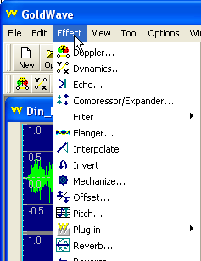
Editing Digital Recording
Digital Signal Processing (Special Effect)
To increase pitch, robot voice, echo, and other special effects.

Slide 24
Summary
Audio means the reproduction of sound.
2. Properties of sound:
  frequency
  wavelength
  period
  amplitude
  speed
3. Characteristics of digital sound:
  Frequency
  Sound resolution
  Channel
  Audio size = Time(in sec)*Frequency/Sampling Rate(in Hz)*Resolution(in bytes)*Channel
5. Example usage of sound in multimedia application:
  Background music
  Sound effects
  Voice over or narration

Slide 25
Summary
  6. Basic sound editing operations:
Trimming
Splicing and Assembly
Volume adjustment
Format conversion
Resampling and Downsampling
Fade-ins and Fade-outs
Equalization
Time stretching
Digital signal processing
Reversing sound

